Slide 1
Cyclops Project
Joanne Yoon, Anurag Bejju, Alex El-Hajj, Denise Chen, Saeid Molladavoudi, Nick Denis, Monica Pickard
Data Science Division, Statistics Canada &
Health Canada

Slide 2
Overview
Problem
Project Scope
Proposed Solution Pipeline
Text Extraction (OCR)
OCR Post-processing
Word classification (NER)
Quality Assurance Proposals
Assessment (NHP/Compliance/Claims)
Future Work

Slide 3
Problem

Slide 4
Problem
Health Canada (HC) agents regulate the sales of “Natural Health Products” (NHP)
Basic HC agent assessment logic:
Product_compliant = True
If NHP:
If can_find_product_in_LNHPD_database:
If ingredients_in_database_don’t_match_ingredients_on_product:
Product_compliant = False
If company_name_and_address_not_on_product:
Product_compliant = False
For each_ingredient_on_image:
If ingredient_is_prohibited: # schedule A, ….
Product_compliant = False
If claims_on_product != claims_approved_in_product_license:
Product_compliant = False
…
Else:
For each_ingredient_on_image:
If ingredient_is_prohibited: # schedule A, ….
Product_compliant = False
If claims_on_product_break_rules:
Product_compliant = False
Else:
…
Return Product_compliant and report_explaining_why

Slide 5
Cyclops Project Scope
Develop a WebApp prototype for HC agents that can:
identify from images:
NHP number
List of ingredients (medicinal and non-medicinal)
Company Name & Address
Product Name
Claims
Allow users to validate extracted text
Perform back-end logic, communicating with required databases via API calls
Provide a final report and assessment on compliance

Slide 6
Not so simple…

Slide 7
Oh, and there are no labels…

Slide 8
Proposed Solution Pipeline
Image
OCR
Fuzzy matching to correct the output of the OCR
User interface
Compliance Assessment (ingredients, claims)
Classification of the corrected words to category: claims, ingredients, product names, company names, NPN
API Calls
(LNHPD API)
User checks OCR result
Completed
Will be done soon
Pending

Slide 9
OCR

Slide 10
Text Detection: Character Region Awareness for Text Detection (CRAFT)
U-net like architecture with 2 heads
Uses weakly supervised learning at the character level

Slide 11
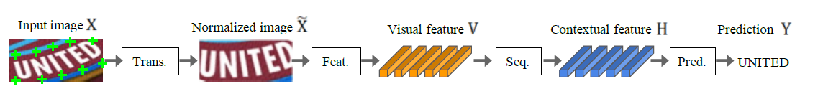
Text Recognition: Deep Text Recognition (DTR)
Thin-plate spline (TPS) transformations
Normalizes (into rectangles) curved characters
ResNet feature extractor
BiLSTM sequence modeling
Attention sequence prediction
Pre-trained (github)

Slide 12
OCR Pipeline
CRAFT – SOTA
Finds letters/numbers well
Can break up words
Not trained on decimals/periods

Slide 13
Examples

Slide 14
Fuzzy Matching Strategy
GOAL:
Classify words from OCR into categories:
{medicinal ingredients, non-medicinal, claim, npn, company name, product name, …}
… but first, we need some QA steps to ensure the fidelity of words extracted via OCR.

Slide 15
Build Master Vocabulary
NHP Online Data
Master word level vocabulary
NHP Product purpose
NHP Products (names)
NHP Product risk
NHP Medicinal ingredients
NHP Non-medicinal ingredients
NHP Companies (names, addresses)
NHP Recommended Dosage
Med. Ingredient: word level vocabulary
.
.
.
Product name: word level vocabulary

Slide 16
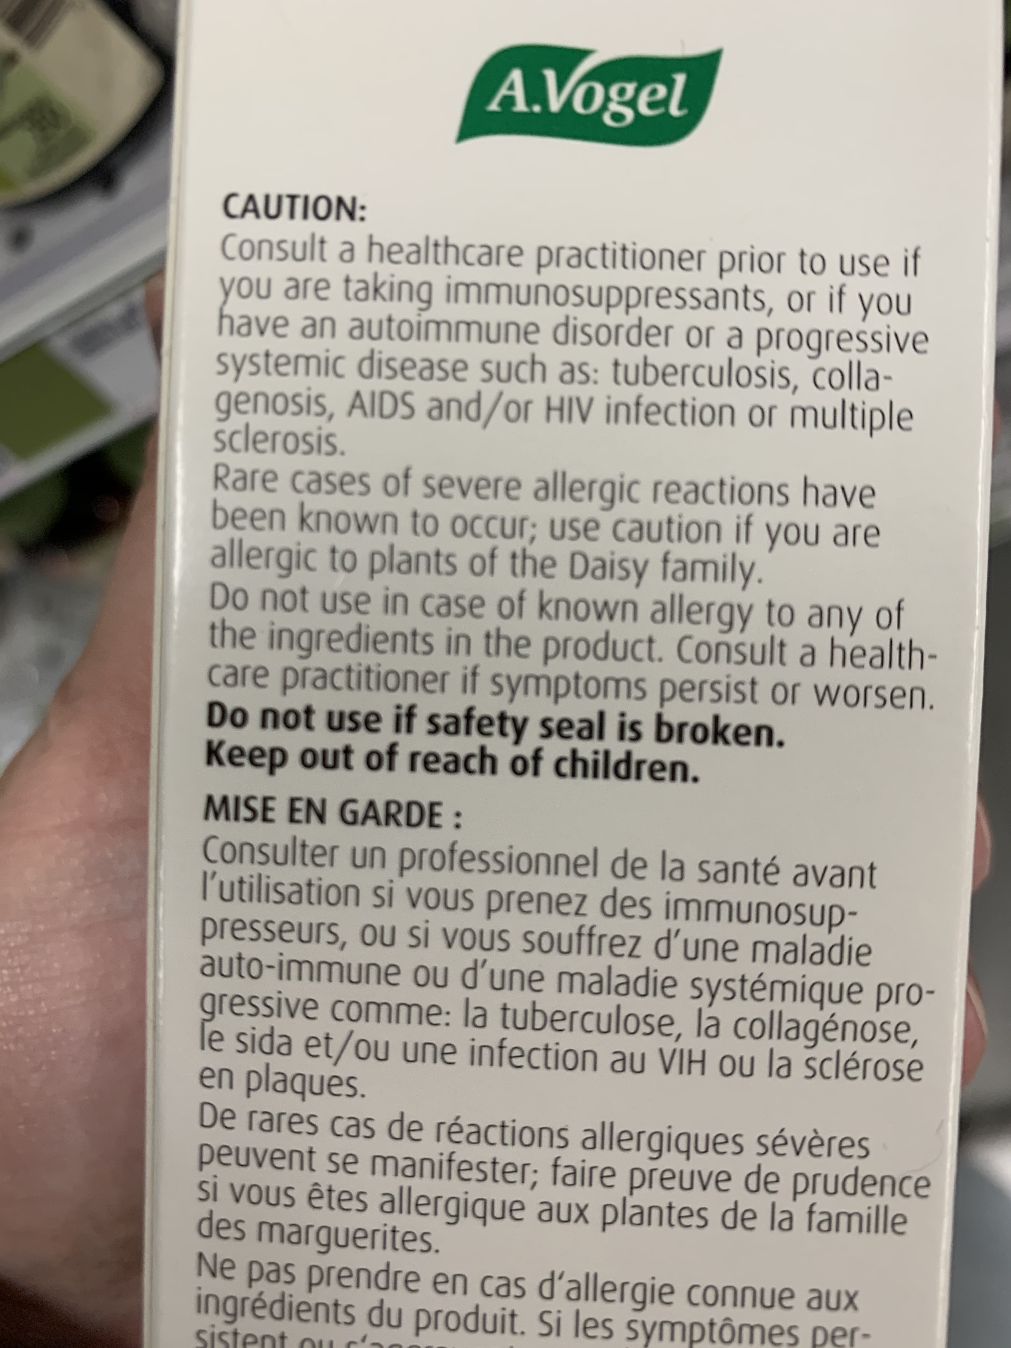
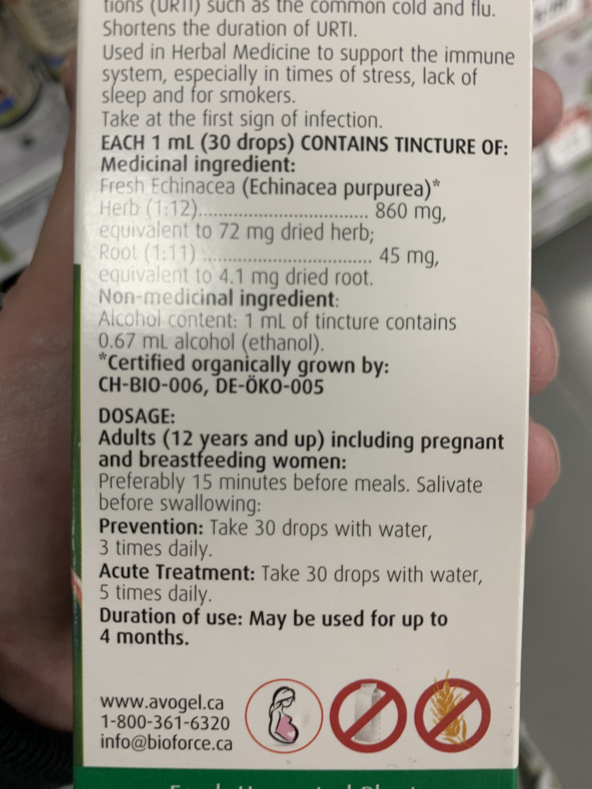
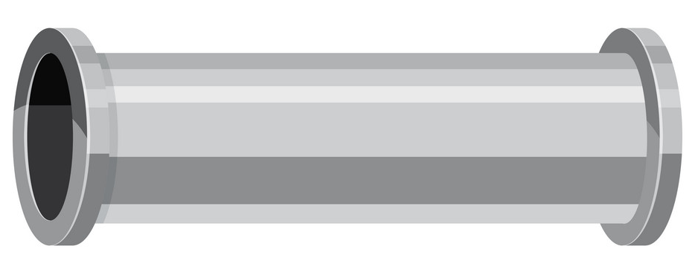
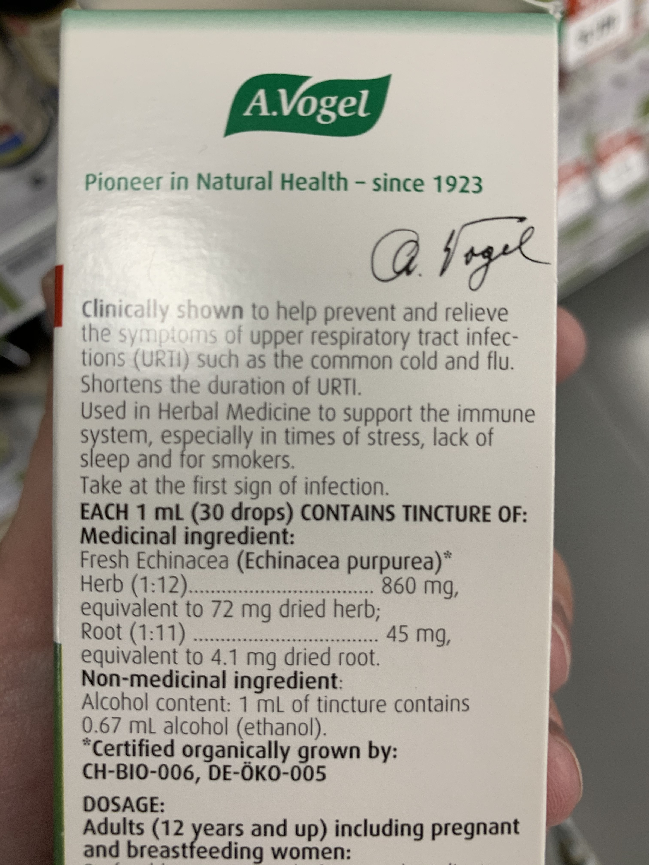
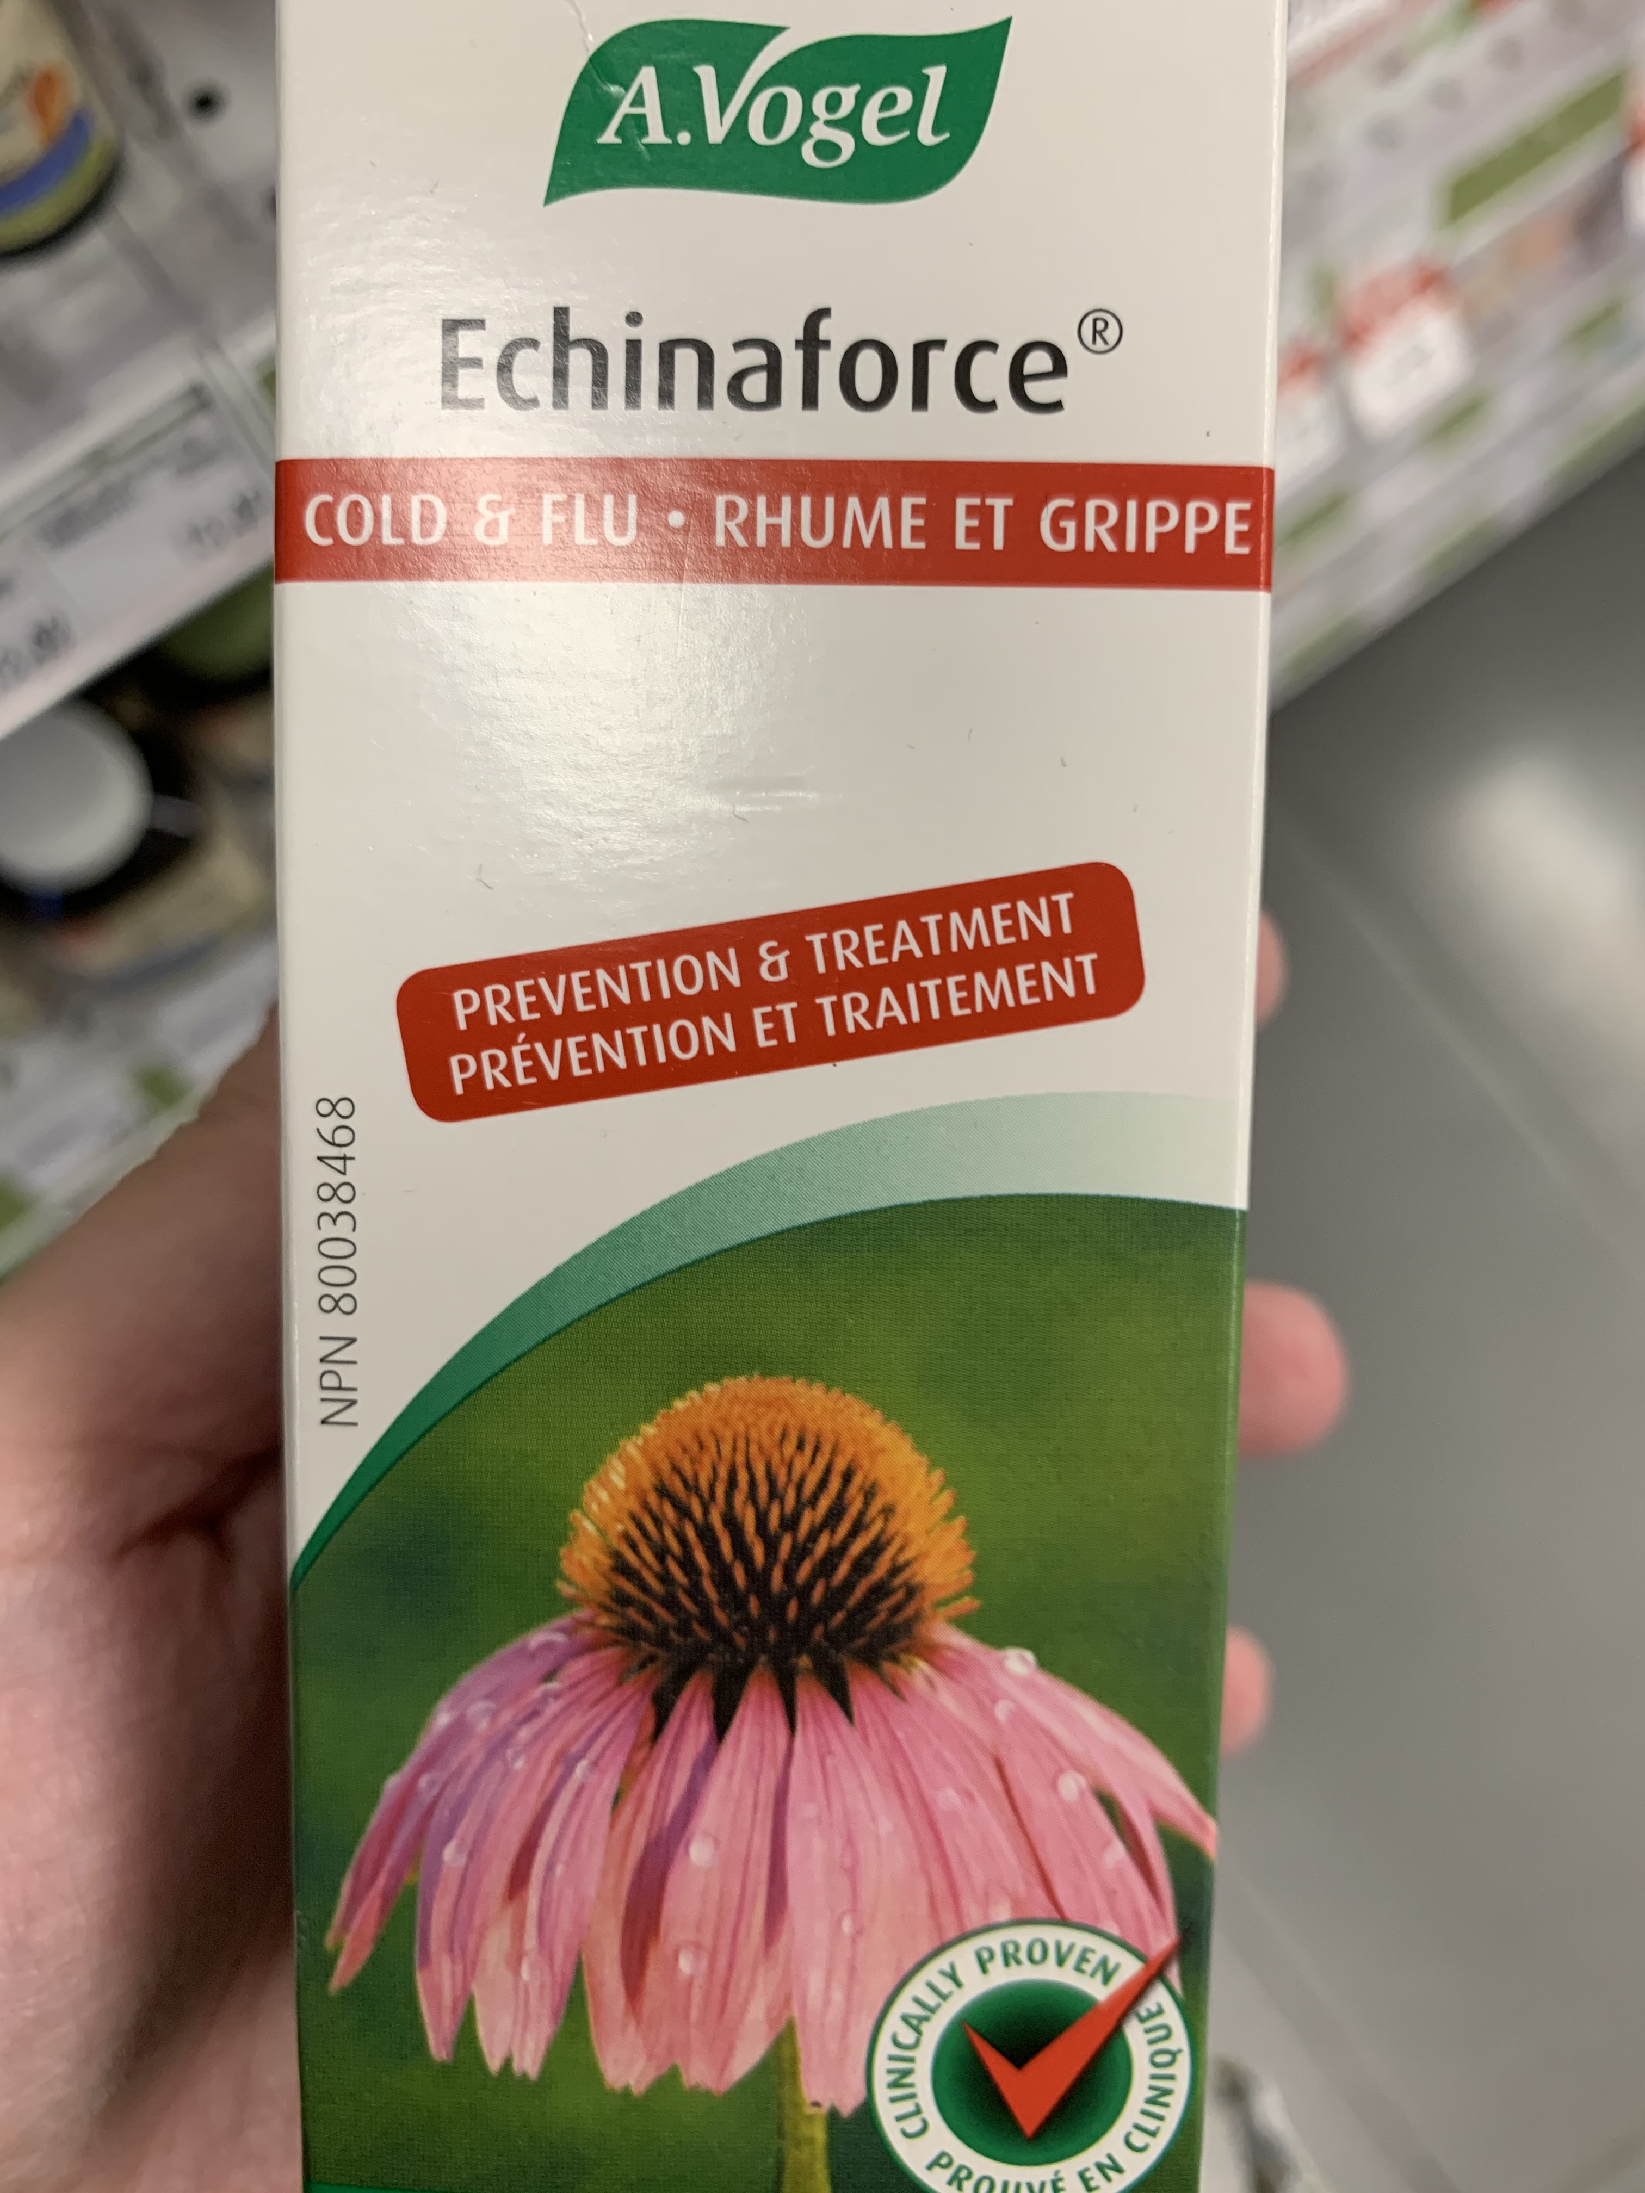
Pre Word Classification Pipeline
{"all_text":
["avogel", "-chinaforce", "cold", "flu", "a", "rhume", "et", "grippe", "treatment", "co", "prevention", "traitement", "et", "prevention", "80038468", "npn", "prove,", "clinically", "cliniqu<", "promet", "en"],
"phrase": [
{"text": "avogel", "all_x": ["1108.8", "1764.0", "1764.0", "1108.8"], "all_y": ["100.8", "100.8", "315.0", "315.0"]},
{"text": "-chinaforce", "all_x": ["807.25366", "1980.0122", "1977.4232", "804.6647"], "all_y": ["545.7102", "559.6716", "777.1408", "763.1794"]},
{"text": "cold", "all_x": ["548.1", "825.3", "825.3", "548.1"], "all_y": ["894.6", "894.6", "1014.3", "1014.3"]},
{"text": "flu", "all_x": ["989.1", "1178.1", "1178.1", "989.1"], "all_y": ["894.6", "894.6", "1014.3", "1014.3"]},
{"text": "rhume", "all_x": ["1304.1", "1713.6", "1713.6", "1304.1"], "all_y": ["900.9", ……..
OCR Pipeline
“OCR OUTPUT”

Slide 17
Pre Word Classification Pipeline
63.4% of OCR words are perfectly matched to Master vocabulary (have seen over 80% for some images)
In-exact matches are mostly improvements (as we would hope), eg:
‘opening.’ - ‘opening’
‘tonsillitis,’ - ‘tonsillitis’
‘use:’ - ‘use’
‘ingredientsi’ – ‘ingredients’
‘montreal.’ - ‘montreal’
‘biotorce’ – ‘bioforce’
‘avogel’ – ‘vogel’
‘drops)’ – ‘drop(s)’
‘ethanol’ – ‘ethanol’
‘ml),’ – ‘ml’
‘nonmedicinal’ – ‘non-medicinal’
‘produit.’ – ‘produit’
‘ccertified’ – ‘certified’
.
2nd round Fuzzy Matching

Slide 18
Fuzzy Matching v2.0
Previous work on FM was successful
Can successfully map OCR with spelling mistakes/punctuation to correct word in master vocabulary
Con:
FM is incredibly slow
Prohibitive for real-time use
Solution:
SymSpell Python Package
Runtime for A. Vogel product (8 images) with ~1000 ocr words
Fuzzywuzzy | symspellpy
421.3 seconds (>7min) | 0.88 seconds

Slide 19
SymSpell– How it works
Pre-compute spelling errors on a provided vocabulary with a max_num_errors (parameter)
“ingredients” → {‘ingredient’, ‘ingredient’, ‘ingredienta’, ‘ingredientb’, ‘ingredientc’, …}
When an error is made by ocr, “ingred1ent$” → symspell returns a list of the top matching original words in your vocabulary

Slide 20
Word Classification: BioNER

Slide 21
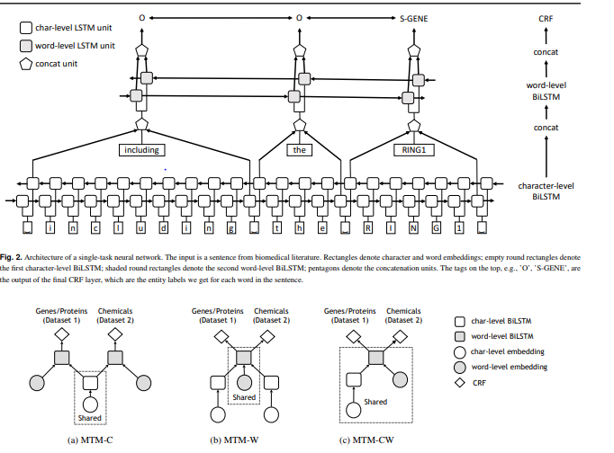
Cross-type Biomedical Named Entity Recognition with Deep Multi-task Learning (Bioinformatics'19)
State-of-the-art Neural network based multi-task learning framework for biomedical named entity recognition
Year: 2019
Developed by: Stanford Uni
Paper: https://arxiv.org/abs/1801.09851
Code: https://github.com/yuzhimanhua/Multi-BioNER

Slide 22
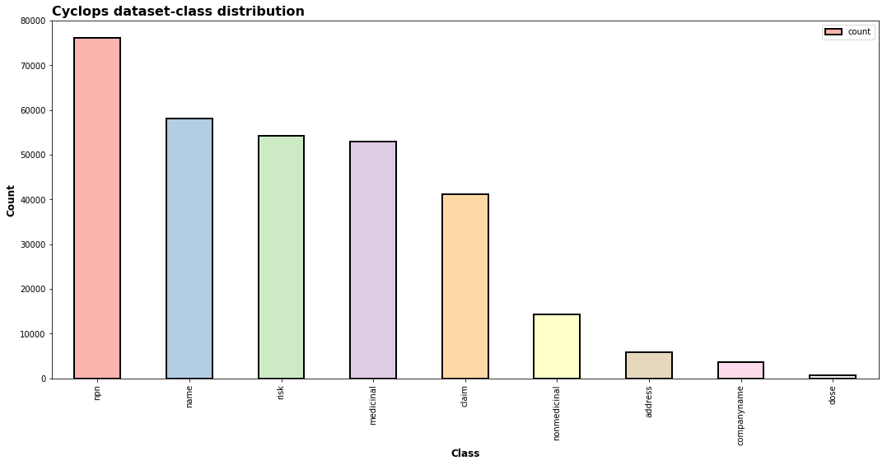
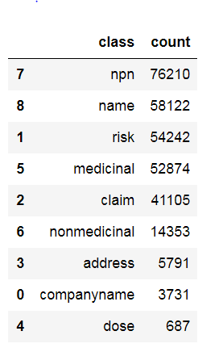
Cyclops: Class - Data Distribution

Slide 23
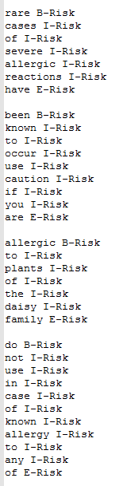
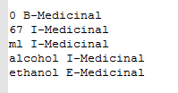
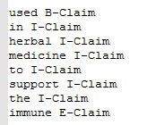
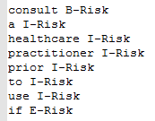
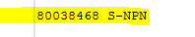
Use Cases tested using newly trained Model
B- Beginning ; I – Intermediate ; E - End

Slide 24
Classification Issues
NHP_OpenCanada datasets are words or sentences
How to form (actual) sentences from OCR output?
Need to train the model on the same data formats (words vs sentences vs …) that will be used at inference time
How to partition/chunk the text in an image into ordered sequences of words…

Slide 25
Graph IE Strikes Again!

Slide 26
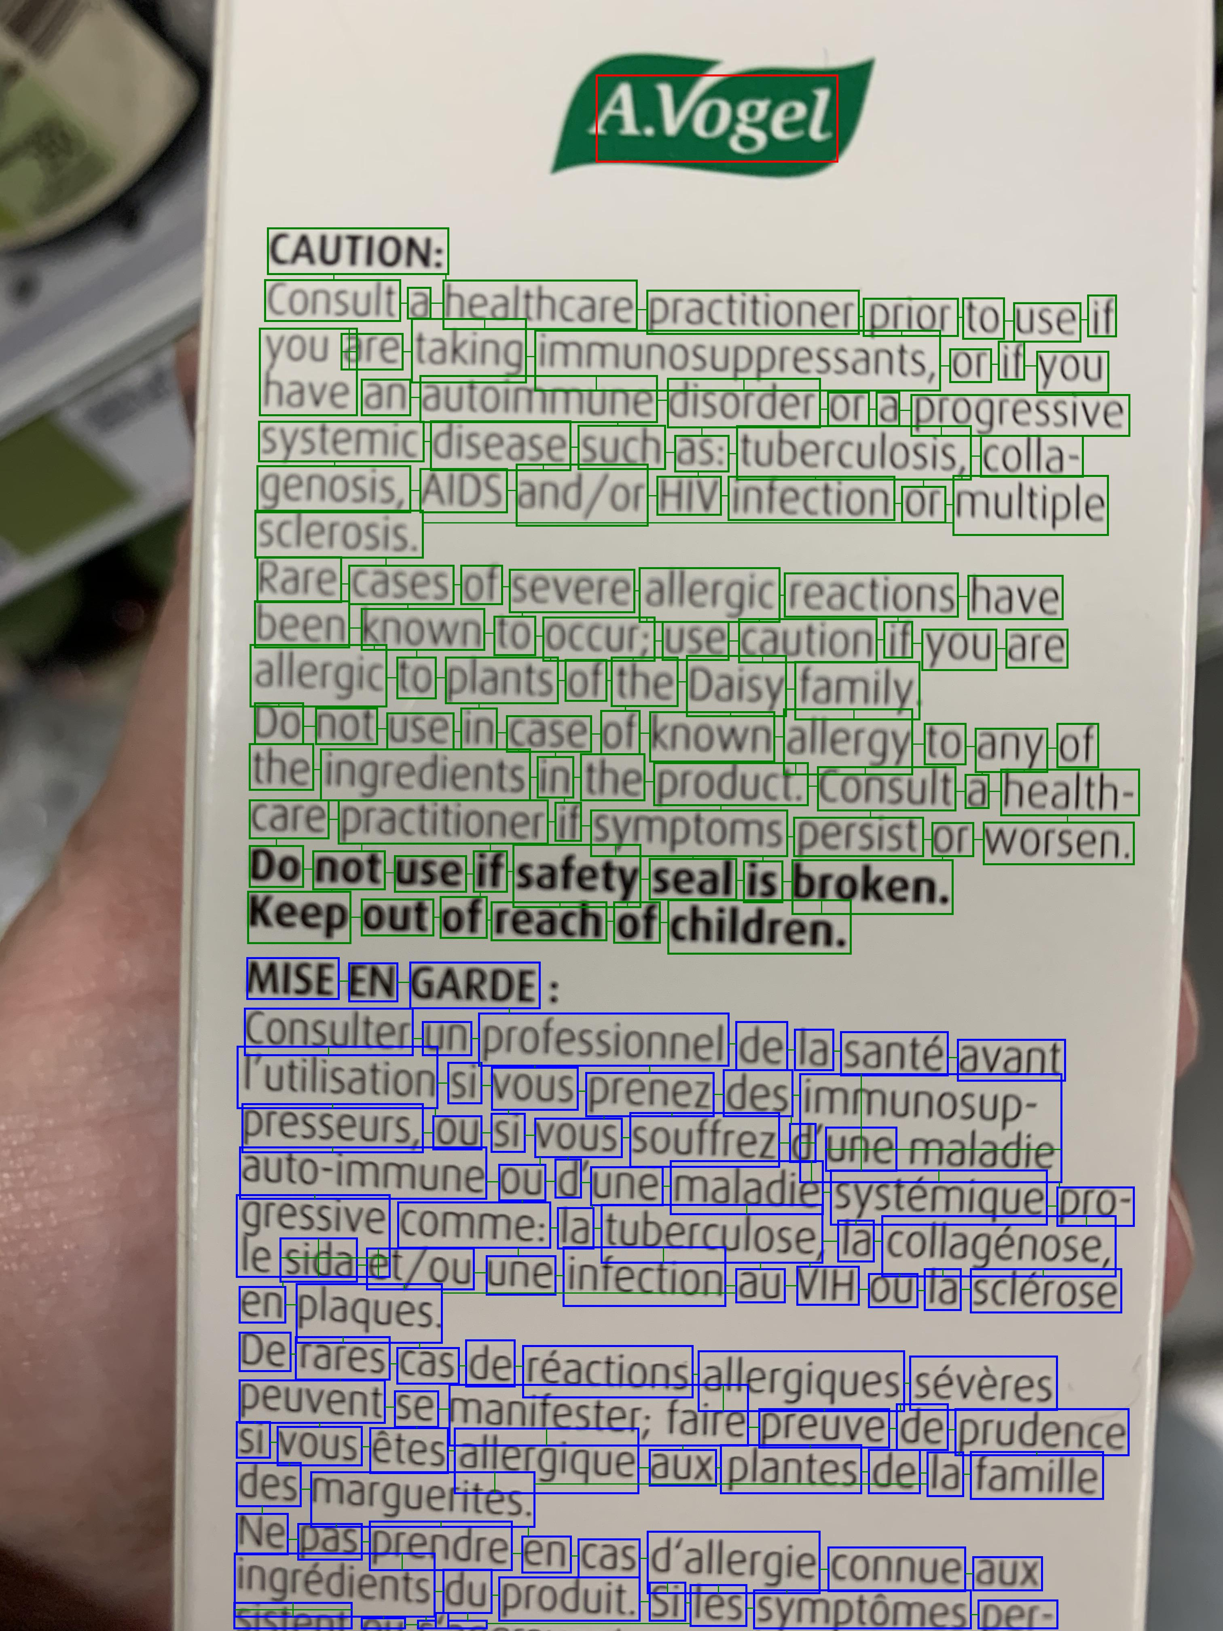
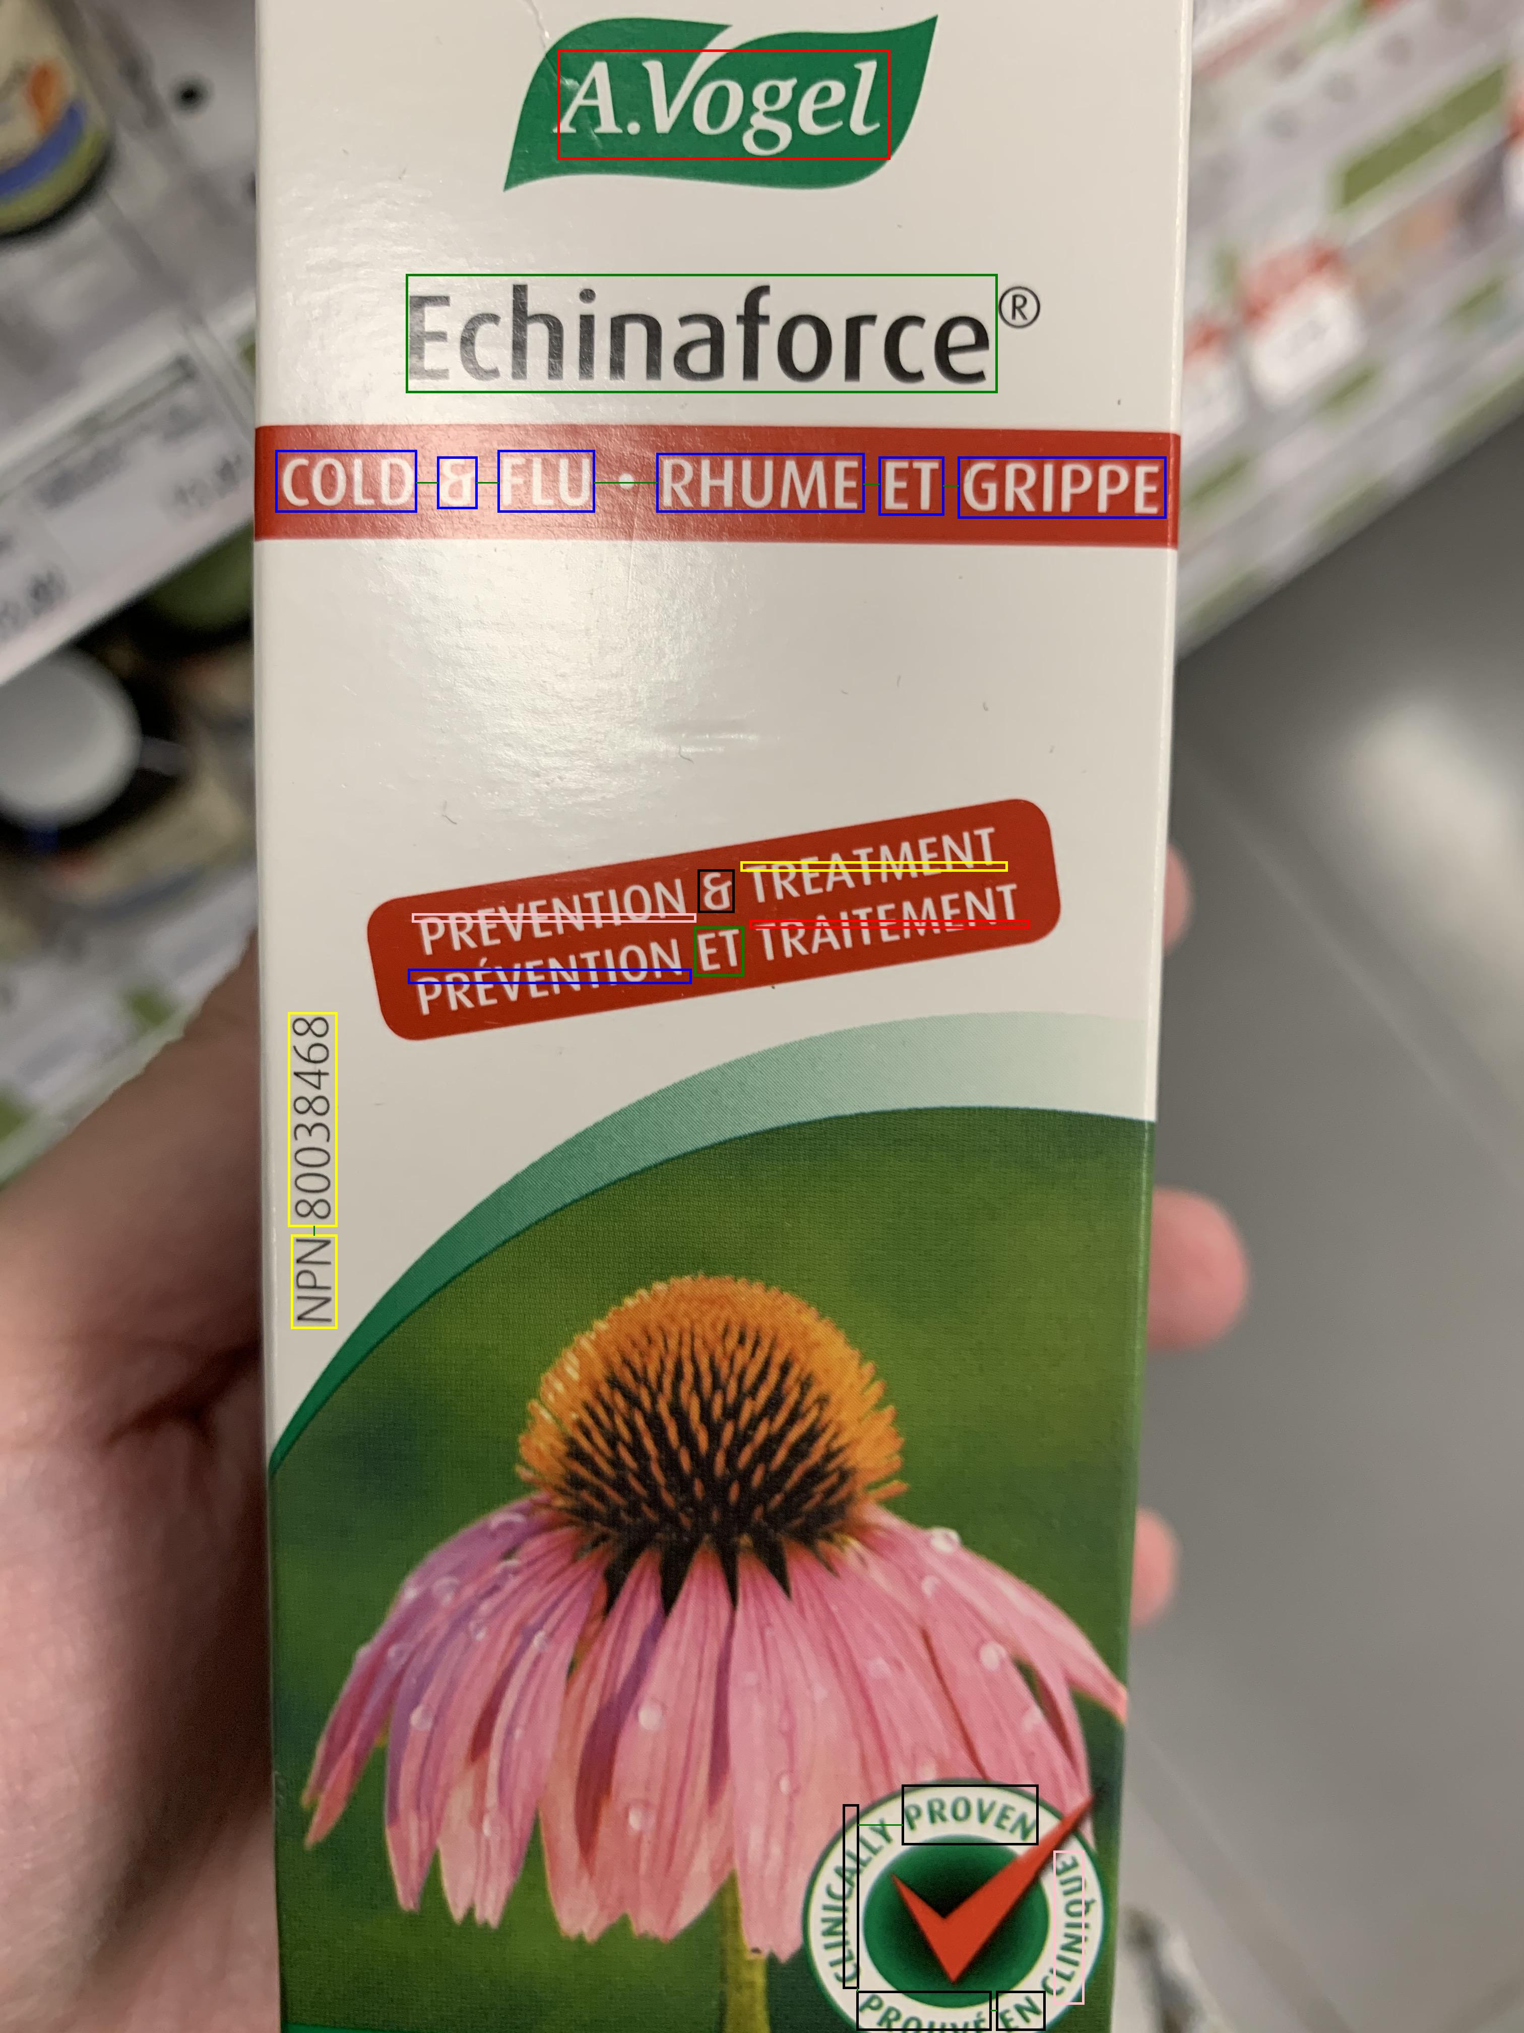
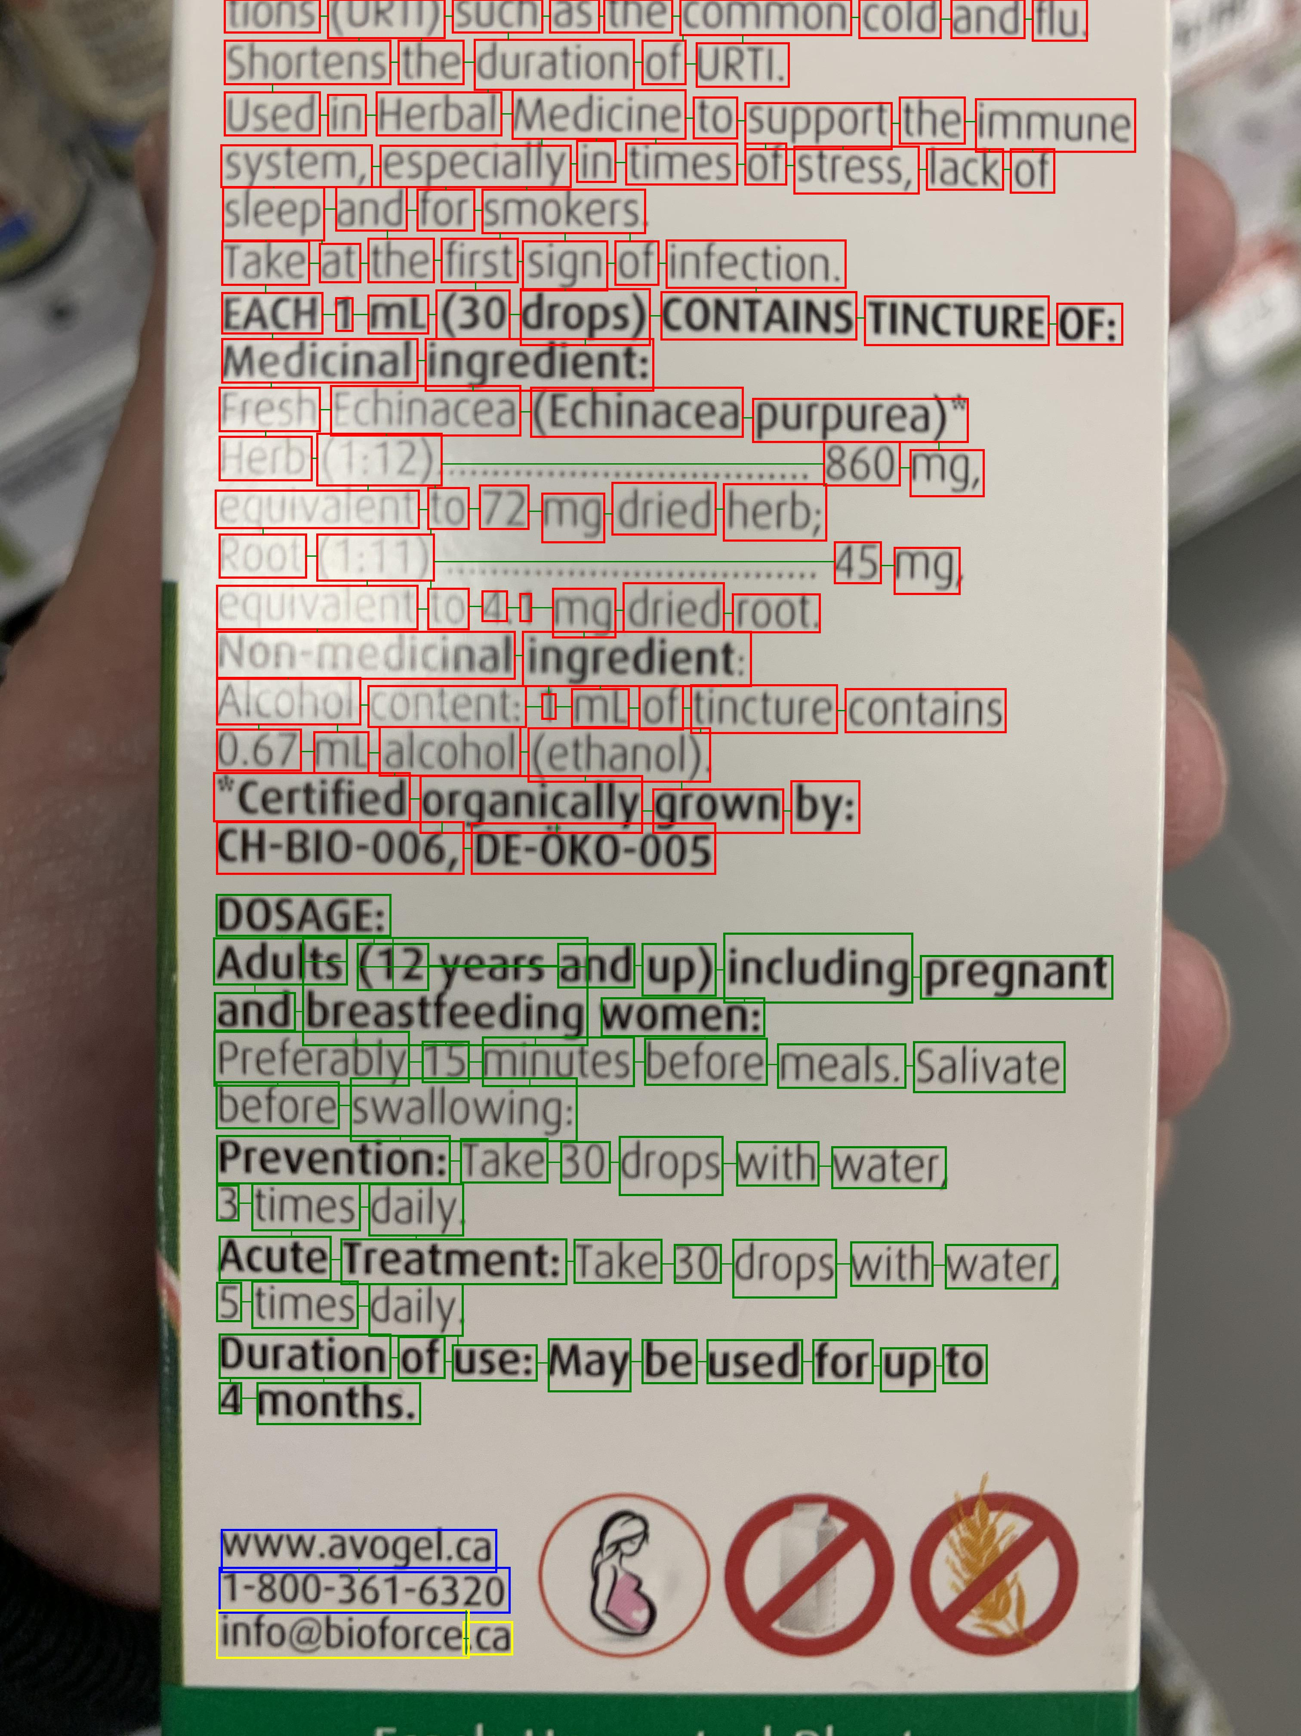
GraphIE

Slide 27
End User QA

Slide 28
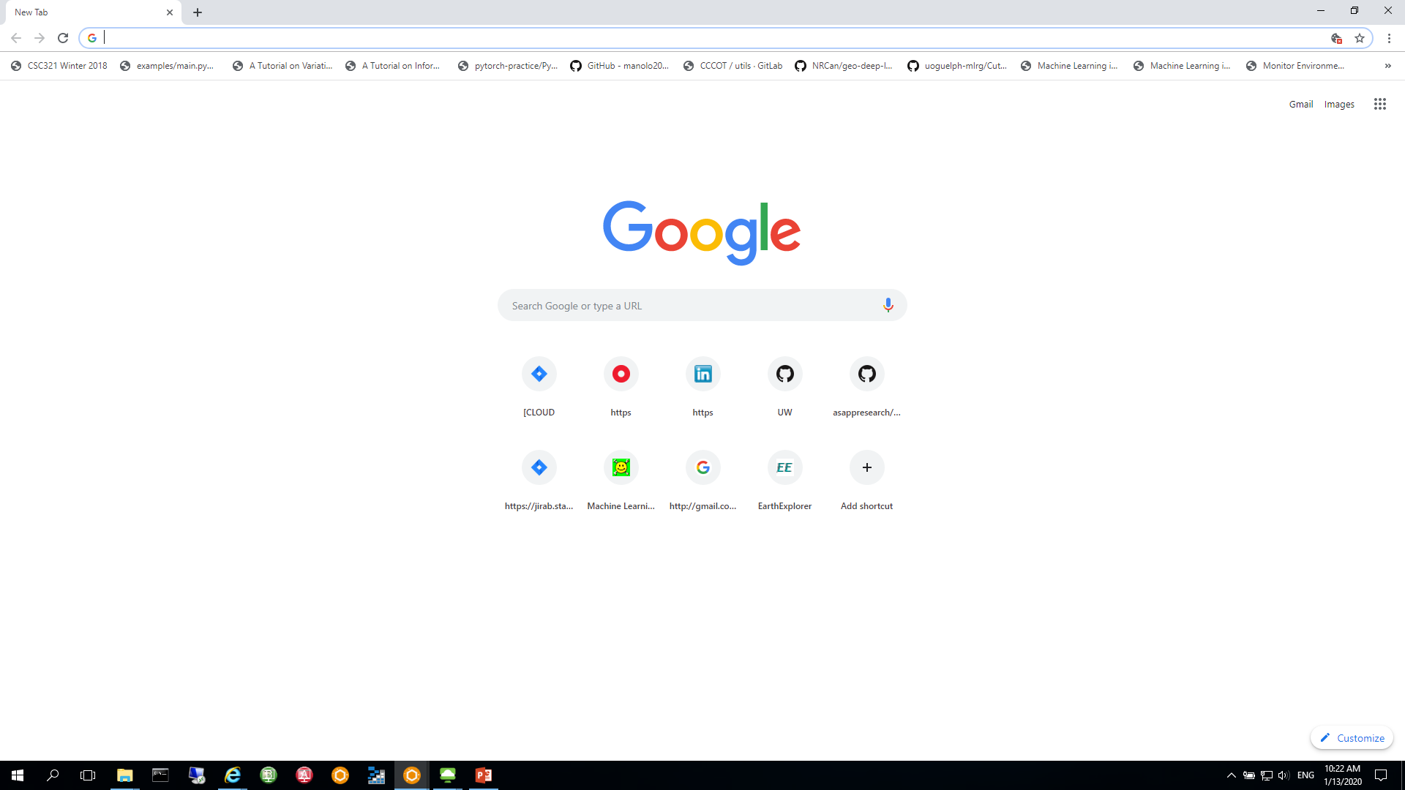

{Relevant Information} Proposals
Extracted:
Medicinal Ingredients
Query the user to confirm extraction
Allows for:
Confirming correct extraction
Spelling correction
Removing unwanted words
Adding missed words
Back-end logic (API calls, NHP assessment, Claims assessment, Compliance assessment)
Final report
Assessments + reasoning
Vitamin a
Vitamin b
Vitamin c
Vitamin d
Add med. Ingredient
Confirm Medicinal Ingredients

Slide 29
Compliance Assessment

Slide 30
Database query (API Calls)
Input OCR extraction text file (json file)
NPN number
Product Name
Company Name
Product_License File
Lnhpd_id
API Query
Medical Ingred
API Query
Non-Medical Ingred
API Query
Med Claims

Slide 31
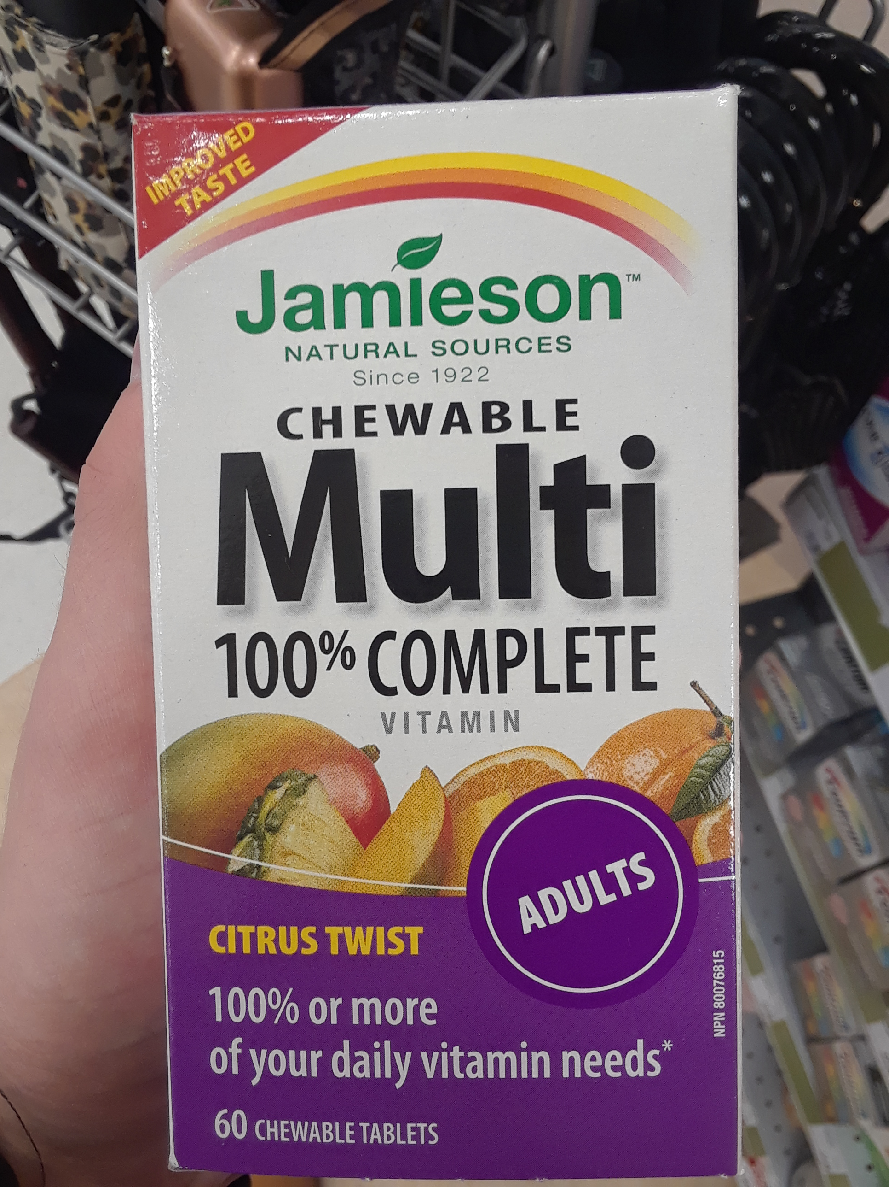
Database query
No NPN number shows up from Medical Image
- Only look at Medical Product Name & Company Name
OCR Extraction
- Product Name: chewable multi 100” complete vitamin
- Company Name: Jamieson
Top 10 matched medical products
- Parental 100 Complete Multivitamin
- Parental Multi 100 Complete
100 Complete MultiVitamin
Multi 100 Complete For Women
Multi 100 Complete For Men
Parental 100 Complete Multivitamin with Dha
Chewable Tropical Vitamin D
Multi 100 Complete For Women 50
Multi 100 Complete Complete Chewable
Correct One
-100% Complete Chewable Multivitamin For Adults

Slide 32
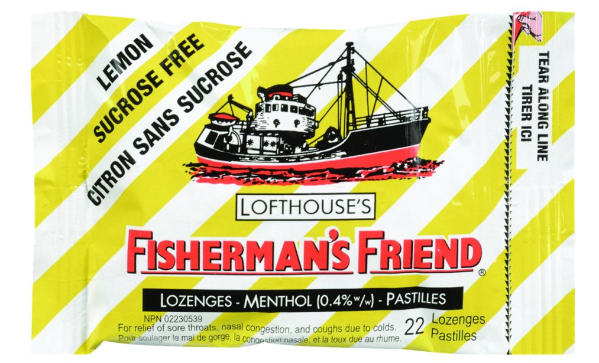
Database query
OCR Extraction
Product Name: lofthouse’s fishermans friend surose free lemon sans sucrose
- Company Name: LOFTHOUSE
Correct One
-Company: TFB & Associates Ltd.

Slide 33
NPN Identification

Slide 34
NPN Extraction Stats
Purpose: To compare the NPN extracted from the annotated images to the NPN extracted from the OCR
Annotated Dataset: 875 products
642 labelled NPN
580 contain a digit
571 (88.9%) have a useable partial NPN, i.e. 3-8 digit NPN that can be used to query the LNHPD database

Slide 35
Comparing the NPN extract with OCR
Comparing the same 642 images with the OCR extract
501 (78%.0) match exactly with the annotated image extract
510 (79.4%) partially match (first 3 digits) with the annotated image extract
npn_annot | filename | all_text | npn_text | npn_ocr | correct | correct2
80037353 | Wobenzym ps_1.jpg | npn 80037353 polarated baldbya wobenzym resooe os colala noten a factor in ankle joint injury recuperation relieves pain associated… | npn 80037353 | 80037353 | 1 | 1
80037553 | Wobenzym ps_2.jpg | medor, npn 80037553 mores hobenzym ds ne to afactor … | npn 80037553 | 80037553 | 1 | 1
80066200 | Zuccarin Diet_1.jpg | natural health prodact produit de santa natural laturally sourced npn 80066200 | npn 80066200 | 80066200 | 1 | 1
80005483 | Wn pharma multivitamin daily_1.jpg | 6 25273! multivitamines czleo un par jour a lot [7455 maintient une bonne sante 80005483… | 80005483 npn | 80005483 | 1 | 1
80054 | Zytec Germ Buster_1.jpg | e zytec not germ busterâ€™ alcohol some free hand sanitizer foam with 80054/83 is alourizers ancel and npn kills harmful bacteria or germs 550 ml 1186 flozj | 80054/83 npn | 8005483 | 0 | 1

Slide 36
Future Work

Slide 37
Future Work
Finish building the word classifier
Iterate and improve on BioNER architecture
Finish product lookup in LNHPD database
NPN based search
Product and company name based search
Claims
Generate claim proposals
Claim assessment
Compliance Assessment
Database calls
Business logic
Web App front end
new casual with extensive web dev experience starts ~ Feb.20
Final prototype delivered: March 31, 2020

Slide 38
Thank You /
Je vous remercie

Slide 39
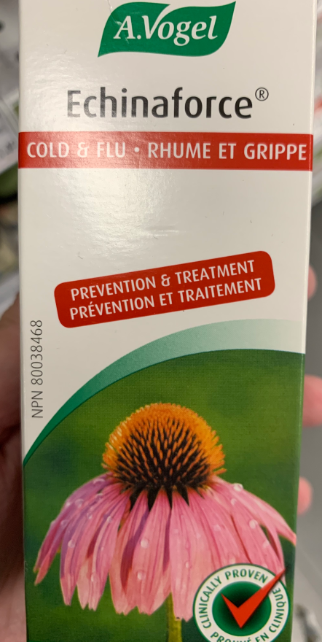
Update on OCR
Company Name
Classification
Human Annotation
Detect and recognize text
Fuzzy matching
Classification to a Type
Annotate image area to a type
Recognize text inside each area
NPN

Slide 40
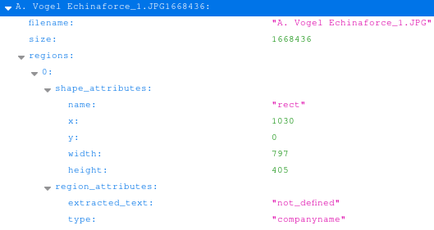
Annotated areas are save in JSON
Annotation JSON

Slide 41
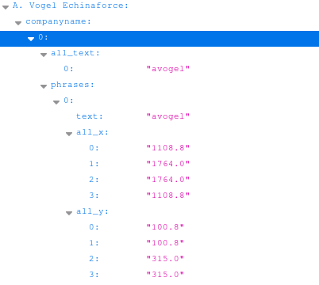
Extract text in the area
to serve as test data
OCR of Annotation JSON

Slide 42
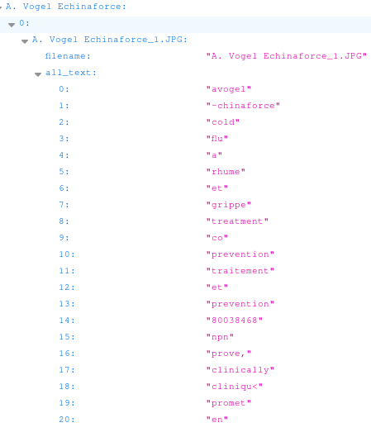
Recognize the text for each type
Raw OCR of Image
Which text in the OCR dump is the Company Name?

